Slide 1
PYTHON FOR DATA SCIENCE UNLOCKING AUTOMOBILE TRENDS PART-1,PART-2
MENTOR: MUNNA PANDEY
SUBMITTED BY :
M.PRIYANKA

Slide 2
UNLOCKING AUTOMOBILE TRENDS PART-1
MARKET SEGEMENT ANALYSIS
Import Excel file into a DataFrame
CODE:
Import pandas as pd
df=pd.read_excel(r'Downloads/DS1_C4_S9_Car_Data.xlsx’)
Df
INTERPRETATION : Here the excel file is imported into dataframe.
A car manufacturer wants to introduce a new car and requires information about the top 5 most preferred car body types. Display the results using a horizontal bar chart.
CODE:
df1=df['Body_Type'].value_counts().sort_values(ascending=False)[:5].reset_index()
df1.columns = ['Body_Type', 'Count’]
df1

Slide 3
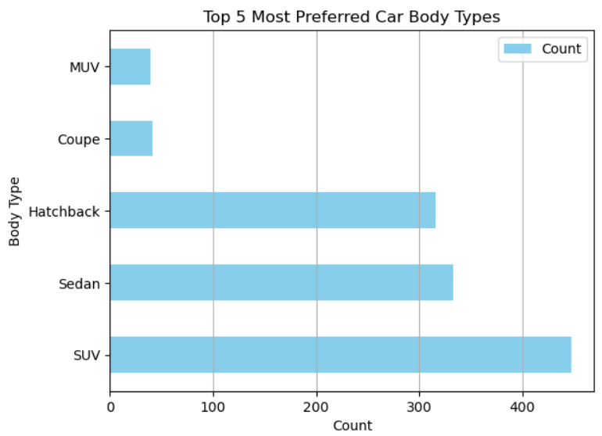
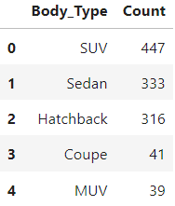
CODE FOR PLOTTING THE GRAPH
df1.plot(kind='barh', x='Body_Type', y='Count', color='skyblue’)
plt.title('Top 5 Most Preferred Car Body types’)
plt.xlabel('Count’)
plt.ylabel('Body Type’)
plt.grid(axis='x’)
plt.show()
OUTPUT
INTERPRETATION: From that we identified the top 5 most preferred car body types

Slide 4
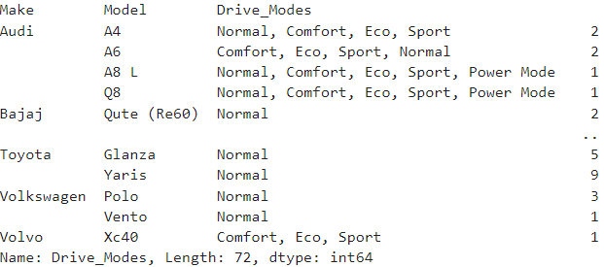
List all the details of cars that can adapt to various driving conditions such as normal, comfort, eco, sport, and power mode . How many cars have all the above-mentioned features?
CODE:
df1 = df[df['Drive_Modes'] != 'Not Available’]
df1 = df1.groupby(['Make', 'Model','Drive_Modes'])['Drive_Modes'].count()
print(df1)
OUTPUT
INTERPRETATION: From that identified the car with their models that can adapt various condition.

Slide 5
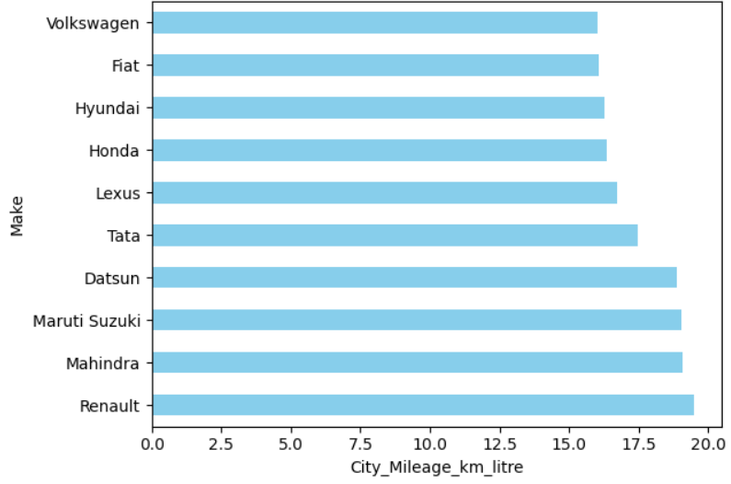
Fuel Efficiency Analysis
Identify the top 10 car manufacturers based on the city mileage and display the result using a horizontal bar graph with the manufacturer on the y-axis and mileage on the x-axis.
CODE:
df1=df.groupby(['Make'])['City_Mileage_km_litre'].mean().sort_values(ascending=False)[:10] OUTPUT
df1.plot(kind='barh’)
plt.xlabel('City_Mileage_km_litre’)
plt.ylabel('Make’)
plt.show()
INTERPRETATION: From that identified the top 10 manufactures and displayed through horizontal bar graph.

Slide 6
Identify the top 20 non-electric car manufacturers based on city mileage and display the results using a bar graph similar to that in task 1.
CODE
import matplotlib.pyplot as plt
non_electric_cars = df[df['Fuel_Type'] != 'Electric’]
avg_mileage = non_electric_cars.groupby('Make')['City_Mileage_km_litre’]
.mean().sort_values(ascending=False)[:20]
avg_mileage.plot(kind='barh', color='skyblue’)
plt.title('Top 20 Non-Electric Car Manufacturers by City Mileage’)
plt.xlabel('Average City Mileage (km/litre)’)
plt.ylabel('Car Manufacturer’)
plt.show()

Slide 7
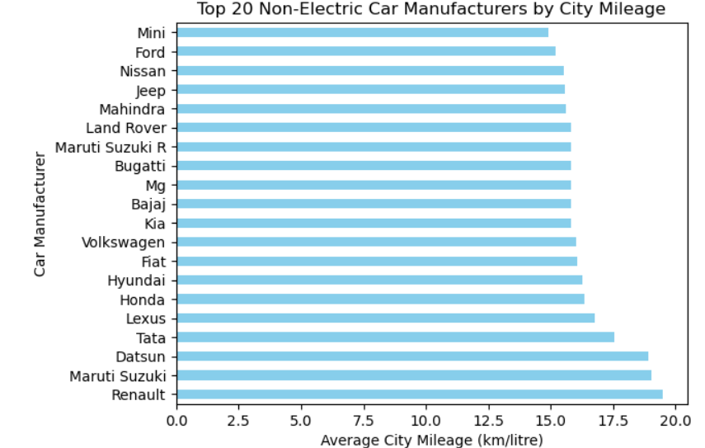
OUTPUT
INTERPRETATION:FROM THAT IDENTIFIED THE TOP 20 NON ELECTRIC CARS.

Slide 8
Display the car mileages for the following four companies using a pivot table: Hyundai, Mahindra, Renault, and Skoda.Create 4 separate pivot tables capturing the following details:
Mean of city mileage
Median of city mileage
Mean of highway mileage
Median of highway mileage
CODE
companies = ['Hyundai', 'Mahindra', 'Renault', 'Skoda’]
filtered_data = df[df['Make'].isin(companies)]
mean_city_mileage = pd.pivot_table(filtered_data, values='City_Mileage_km_litre', index='Make', aggfunc='mean’)
median_city_mileage = pd.pivot_table(filtered_data, values='City_Mileage_km_litre', index='Make', aggfunc='median’)

Slide 9
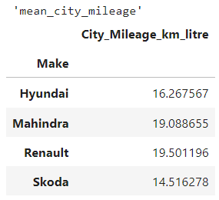
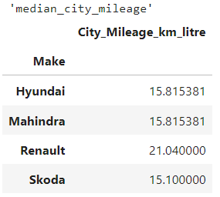
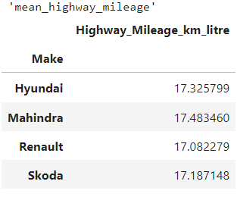
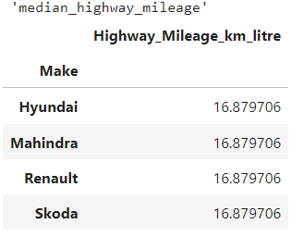
mean_highway_mileage = pd.pivot_table(filtered_data,values='Highway_Mileage_km_litre', index='Make', aggfunc='mean’)
median_highway_mileage = pd.pivot_table(filtered_data, values='Highway_Mileage_km_litre', index='Make', aggfunc='median’)
display(mean_city_mileage) OUTPUT
display(median_city_mileage)
display(mean_highway_mileage)
display(median_highway_mileage)
INTERPRETATION: From this iden
tified the mean and median of city
mileages of Hyundai, Mahindra,
Renault, and Skoda.

Slide 10
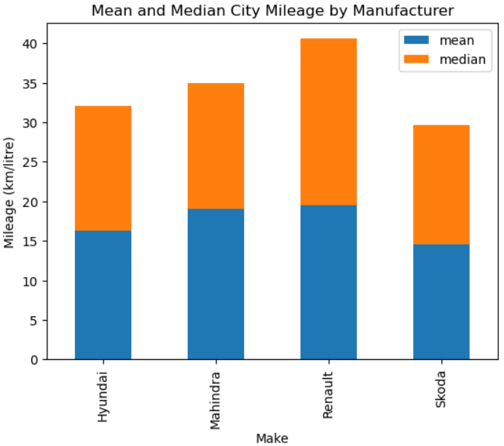
Display the mean and median values of city mileages of the following manufacturers, using a stacked column chart: Hyundai, Renault, Mahindra, and Skoda
import matplotlib.pyplot as plt OUTPUT
manufacturers = ['Hyundai', 'Renault', 'Mahindra', 'Skoda’]
filtered_df = df[df['Make'].isin(manufacturers)]
city_mileage_stats = filtered_df.groupby('Make’)
['City_Mileage_km_litre’]
.agg(['mean', 'median’])
fig, ax = plt.subplots()
city_mileage_stats.plot(kind='bar', stacked=True, ax=ax)
ax.set_ylabel('Mileage (km/litre)’)
ax.set_title('Mean and Median City Mileage by Manufacturer’)
plt.show()
INTERPRETATION: From this displayed the mean and median through the stacked chart.

Slide 11
Plot a line chart to understand the relation between displacement and city mileage by choosing the top 10 cars with the highest city mileage.What do you infer from this graph? Are there any unusual observations? If yes, how would you resolve these?
CODE
top_10_cars = df.nlargest(10, 'City_Mileage_km_litre').sort_values(by='City_Mileage_km_litre',ascending=True)top_10_carsplt.figure(figsize=(10, 6))
plt.plot(top_10_cars['Displacement'], top_10_cars['City_Mileage_km_litre'], marker='o', linestyle='-’)
plt.title('Displacement vs City Mileage of Top 10 Cars', fontsize=14)
plt.xlabel('Displacement', fontsize=10)
plt.ylabel('City Mileage', fontsize=10)
plt.tight_layout()
plt.show()

Slide 12
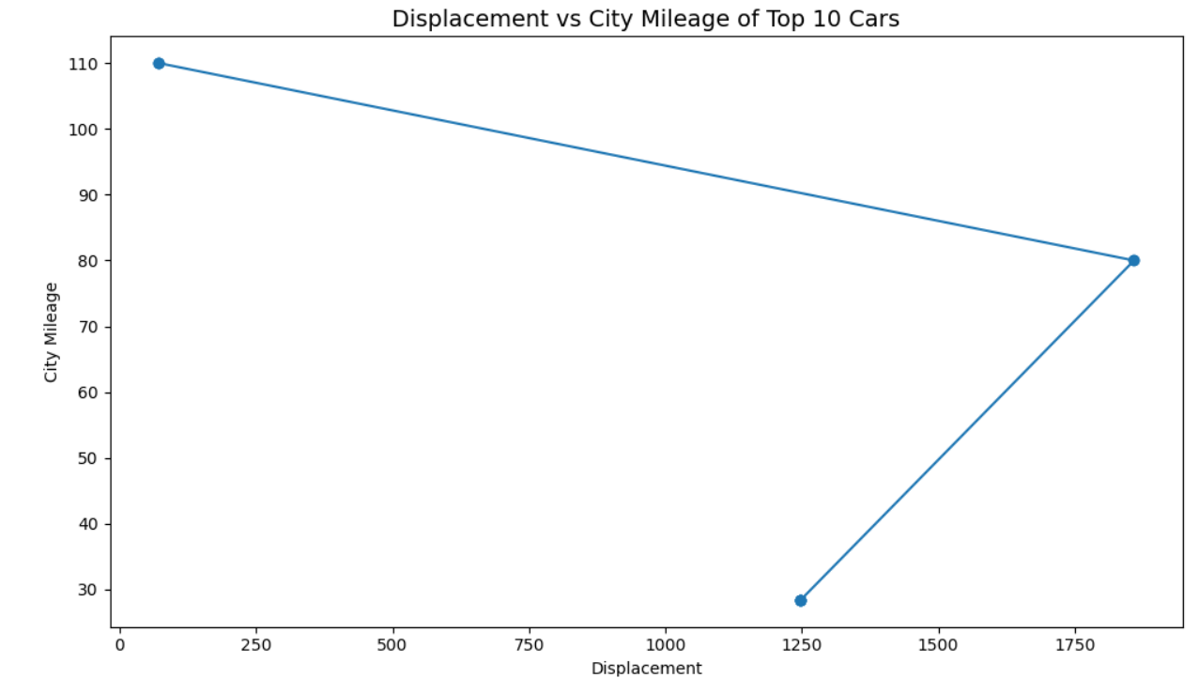
OUTPUT
The graph offers valuable insights into how displacement relates to city mileage among different car models. By analyzing the trends and investigating any unusual observations, we can gain a deeper understanding of vehicle performance and the factors influencing fuel efficiency. This approach not only enhances our comprehension of the data but also guides potential improvements in future car designs
INTERPRETATION: From this identified the relation between displacement and city mileage by choosing the top 10 cars with the highest city mileage

Slide 13
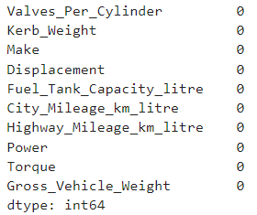
Create another data frame that includes only the following columns from the data. Perform missing value treatment, if required. Valves_Per_Cylinder,Kerb_Weight,Make,Displacement,Fuel_Tank_Capacity_litre,City_Mileage_km_litre,Highway_Mileage_km_litre,Power,Torque,Gross_Vehicle_Weight.
CODE: OUTPUT
import pandas as pd
selected_columns = df[[ 'Valves_Per_Cylinder’,
'Kerb_Weight', 'Make', 'Displacement’,
'Fuel_Tank_Capacity_litre', 'City_Mileage_km_litre', 'Highway_Mileage_km_litre', 'Power', 'Torque', 'Gross_Vehicle_Weight’]]
selected_columns
selected_columns.isnull().sum() #FOR NULL VALUES TREATMENT
INTERPRETATION: From that determined the another data from original data.

Slide 14
UNLOCKING AUTOMOBILE TRENDS PART-1
User Comfort Exploration
Explore seating capacity, central locking, and child safety locks to understand user comfort and family friendly features .
Hint: calculate average seating capacity and count occurrence of central locking,and child safety lock.
CODE:
df1=df[['Seating_Capacity']].mean() ## output:
df1
df2 = df[df['Central_Locking'] != 'Not Available']['Central_Locking'].count()
df2 ## output:1127
df3 = df[df['Central_Locking'] != 'Not Available']['Central_Locking'].count()
df3 ##output:1201
Seating_Capacity 5.270079 dtype: float64

Slide 15
Conclusion: The analysis of vehicle data provides some valuable information about city mileage and safety features and fuel efficiency etc….
Fuel Efficiency: Renault has higher city mileage compared to other cars, showing it as superior fuel effieciency compared to other manufacturers like Mahindra and Maruti Suzuki.
Safety Features: Now-a-days Many vehicles now come with important safety features like child safety locks, seat belt reminders. This shows that car manufacturers are prioritizing passenger safety and making it a standard across different models. These features help reduce risks and ensure a safer driving experience for everyone on board.
Market Trends: The data reflects current market preferences for vehicles that balance fuel eciency and safety. As consumers become more environmentally conscious, manufacturers may need to focus on improving fuel economy alongside integrating advanced safety technologies.

Slide 16
THANK YOU

